Slide 1
South America The Continent Series
VMS Library 2008-2009

Slide 2
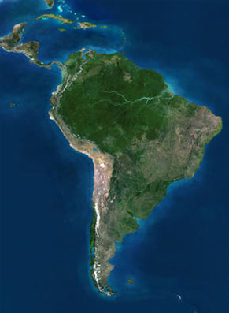
Satellite View

Slide 3
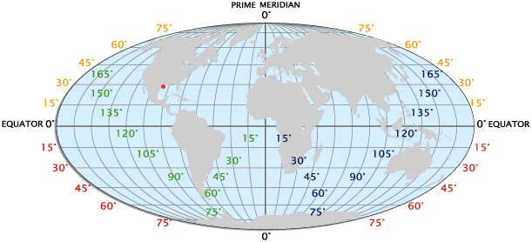
Longitude / Latitude

Slide 4
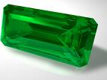
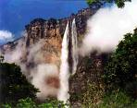
Unique Features
▄ Columbia supplies 90% of the
world production of Emeralds►
▄ Driest place on earth is the Atacama Desert in Argentina
▄ Venezuela has the highest uninterrupted water fall, Angel Falls at 3211 feet ►

Slide 5
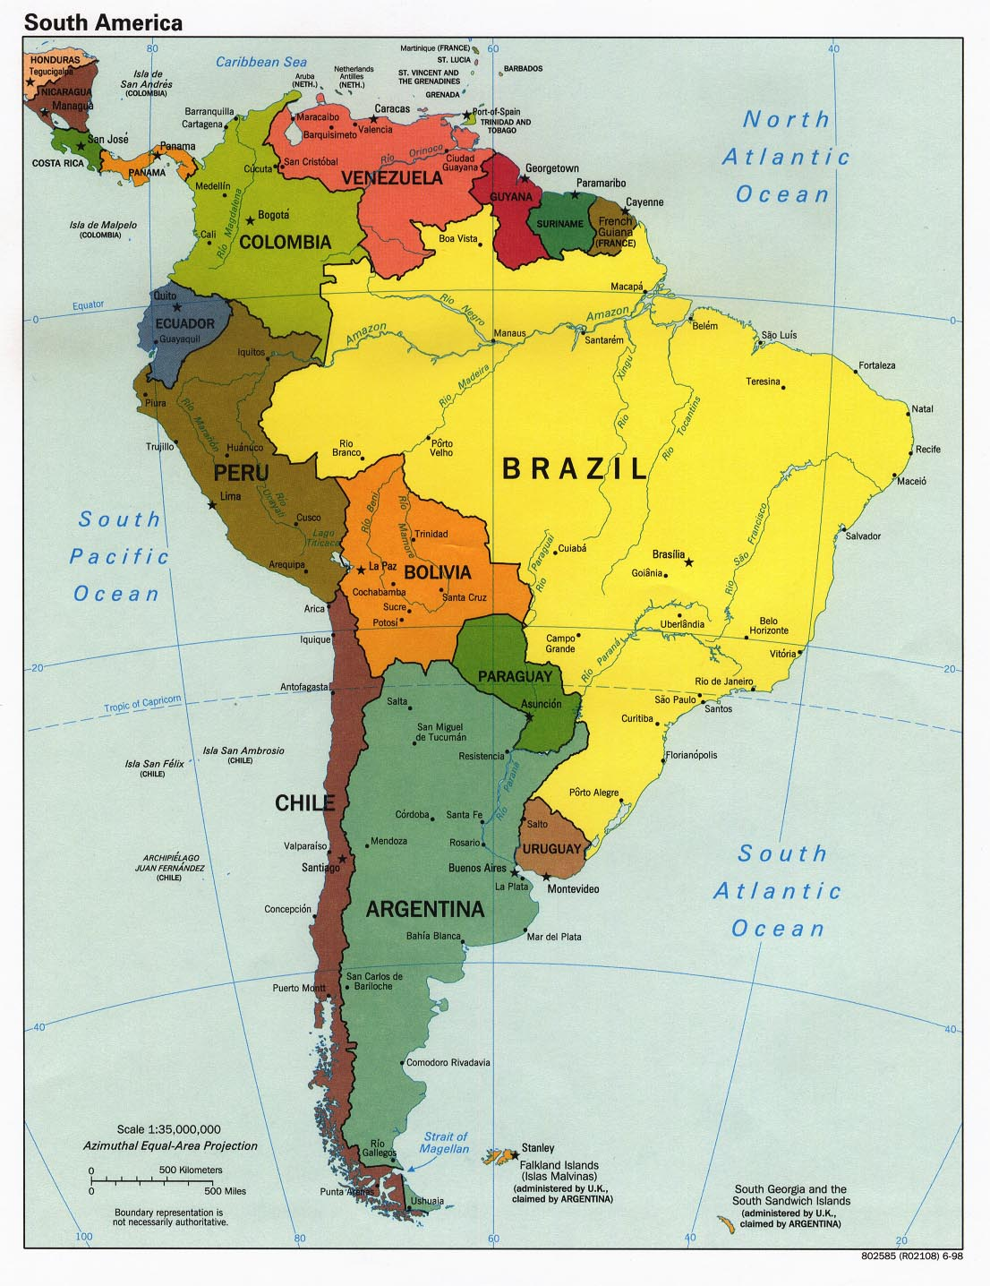
South America’s Size
▄4th largest continent
▄ 6,879,000 sq miles
▄ 12% of the earth’s land

Slide 6
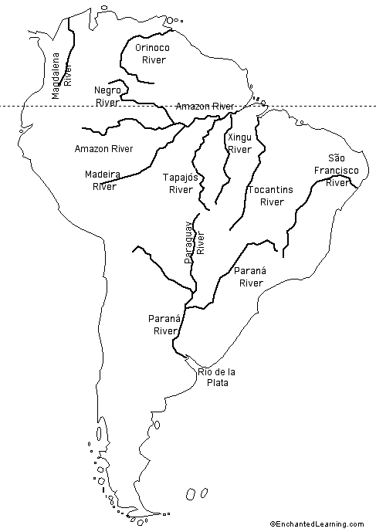
Bodies of Water

Slide 7
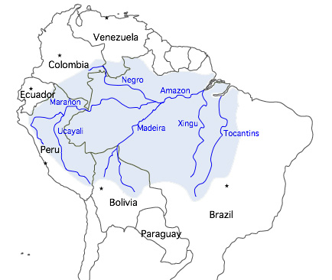
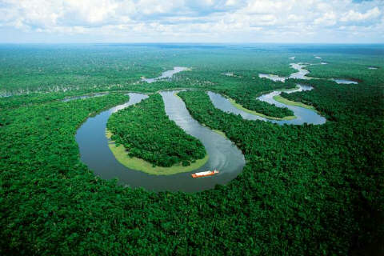
Amazon River
▄ 4,300 miles long
▄ Flows through 6 countries
▄ No bridges cross it
▄ Satellite View

Slide 8
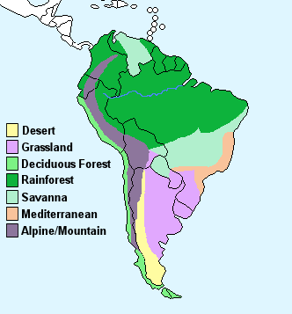
Climate

Slide 9
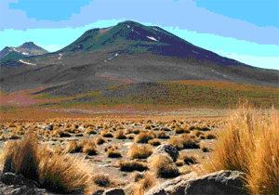
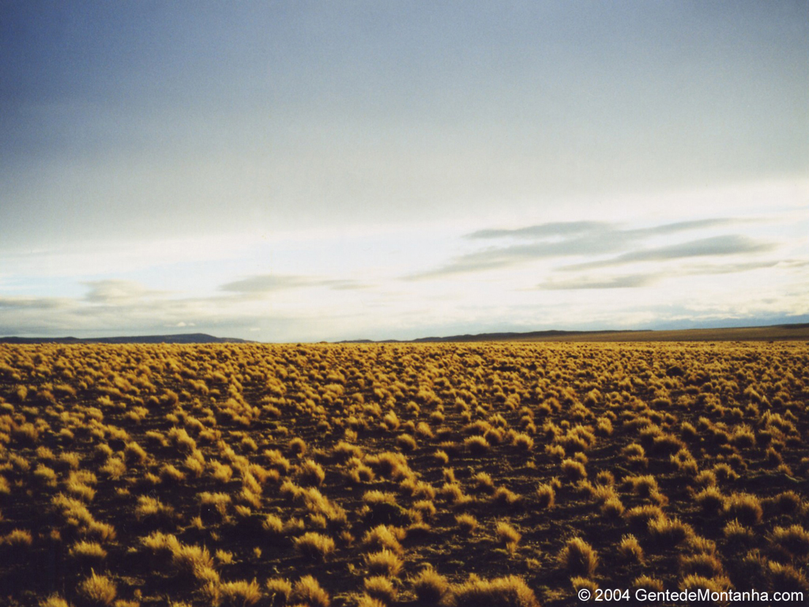
Deserts
▄ Atacama Desert is the worlds’ driest
◄
▄ Patagonian Desert►
Largest in Americas/5th in the world

Slide 10
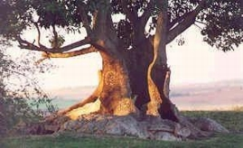
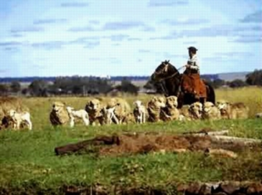
Pampas - Grassland
▄ Just below Buenos Aires
▄ Average temperature is 18°c
▄ Dry season is summer (December)
◄Ombu is tree like plant

Slide 11
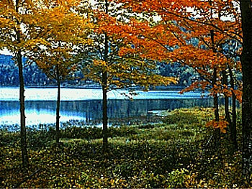
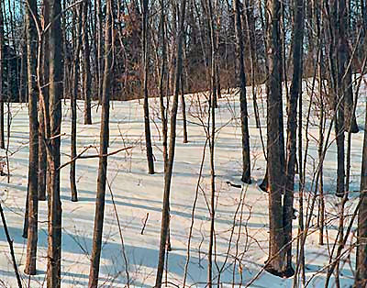
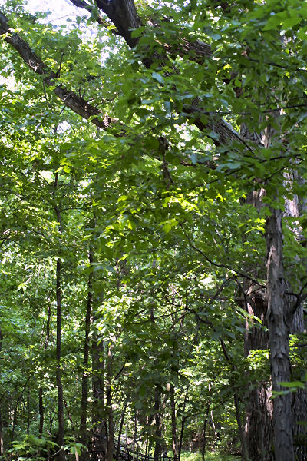
Deciduous Forest
▄ Southern Chile
▄ Middle East coast of Paraguay
▄ Four distinct seasons
Fall ▼ Winter ▼ Summer ▼

Slide 12
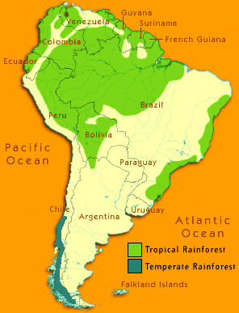
Rainforest
Half of the rainforest
in the world is in the
Amazon region

Slide 13
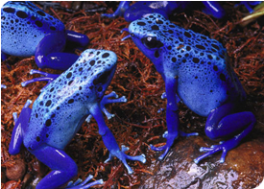
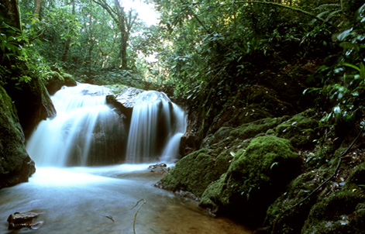
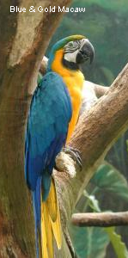
Rainforest
◄Blue Poison Dart Frog
◄Blue/Gold
Macaw

Slide 14
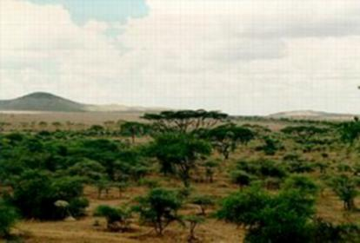
Savannah
▄ The area between a rainforest and desert.
▄ 2.5 million sq kilometers {1/4 the size of Canada}

Slide 15
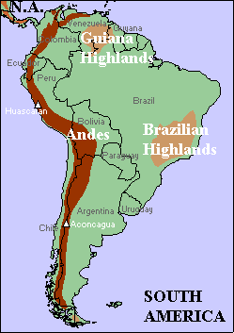
Alpine Mountains
Andes stretch 4,000 miles
from the north to the south, thus making it the longest mountain range in the world. In Chile, it rises to over 20,000 feet.
.

Slide 16
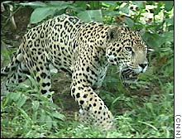
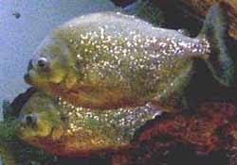
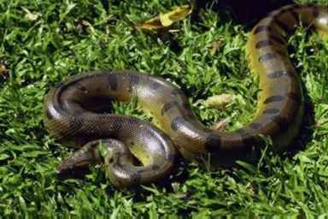
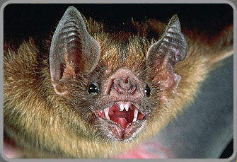
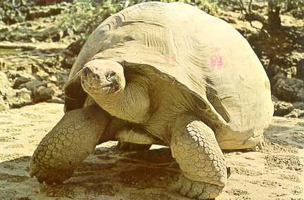
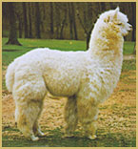
Animals
Jaguar Piranha Anaconda
▄ 12-15 years ▄NA ▄ 15-30 years
▄ 100-250 pounds ▄NA ▄ up to 300 pounds
Vampire Bat Galapagos Tortoise Alpaca
▄ 9 years ▄ 100 years ▄ 24 years
▄ 2 ounces ▄ 450 pounds ▄130 pounds

Slide 17
This powerpoint was kindly donated to www.worldofteaching.com
http://www.worldofteaching.com is home to over a thousand powerpoints submitted by teachers. This is a completely free site and requires no registration. Please visit and I hope it will help in your teaching.

